Slide 1
Performance Evaluation
Prof. Michael Tsai
2019 Spring

Slide 2
Insertion Sort: Ex.
Blue: the range that has completed sorting
Green: currently processing
i | 1 | 2 | 3 | 4 | 5 | 6
A[i] | 5 | 2 | 4 | 6 | 1 | 3
i | 1 | 2 | 3 | 4 | 5 | 6
A[i] | 2 | 5 | 4 | 6 | 1 | 3
i | 1 | 2 | 3 | 4 | 5 | 6
A[i] | 2 | 4 | 5 | 6 | 1 | 3
i | 1 | 2 | 3 | 4 | 5 | 6
A[i] | 2 | 4 | 5 | 6 | 1 | 3
i | 1 | 2 | 3 | 4 | 5 | 6
A[i] | 1 | 2 | 4 | 5 | 6 | 3
i | 1 | 2 | 3 | 4 | 5 | 6
A[i] | 1 | 2 | 3 | 4 | 5 | 6
Notes:
The green (processing) number will compare itself with the number in the “sorted range”, starting from the rightmost one.
If the green number is larger, the blue number will move one slot to its right.
Continue to do this until the green number is NOT larger than the blue number.

Slide 3
Analyzing an Algorithm
Predict the resources an algorithm requires
Example:
Time complexity: the time required to complete the execution of the entire algorithm / program.
Space complexity: the space (memory) required to complete the execution of the entire algorithm/ program.
Notes:
Memory, communication bandwidth, computer hardware (storage, etc.)
And, most often, Computation time.

Slide 4
Input size
Larger input takes more time (or space) to compute
Goal: to determine how (quickly) the required time and space grows as the input size increases.
Therefore, we often define the performance as a function the input size n: T(n), S(n)
What is “input size”?
Examples:
The size of the array
The dimensions of a matrix
The exponent of the highest order term in a polynomial
The number of bits in a binary number
Notes:
In other words, determine the running time / space as a function of the input size.

Slide 5
Insertion-Sort(A)
for j=2 to A.length
key=A[j]
i=j-1
while i>0 and A[i] > key
A[i+1]=A[i]
i=i-1
A[i+1]=key
每回合選一個來做insertion
要排的數值是key
從前一個開始看
把比key大的往右邊移
最後把key填入空出來的那一格
j=6
i | 1 | 2 | 3 | 4 | 5 | 6
A[i] | 1 | 2 | 4 | 5 | 6 | 3

Slide 6
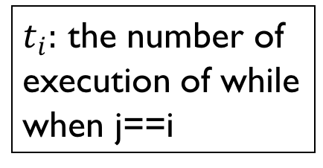
Running Time
n=A.length
$t_{i}:$ the number of execution of while when j==i
Notes:
Understand what this insertion-sort algorithm does. (reading assignment & the previous slide)
Cost of each instruction would be different! (but not very relevant to the “growth” as the input size increases, as we will see later
Count the number of times required for each line or instruction

Slide 7
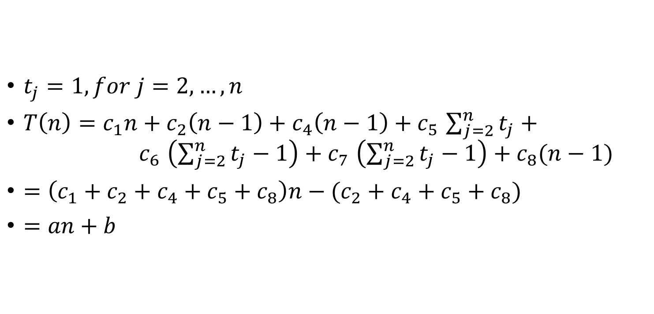
Best case
i | 1 | 2 | 3 | 4 | 5 | 6
A[i] | 1 | 2 | 3 | 4 | 5 | 6
$t_{j}=1, for j=2,…,n$
$T\left(n\right)=c_{1}n+c_{2}\left(n−1\right)+c_{4}\left(n−1\right)+c_{5}$ $\sum_{j=2}^{n}{t_{j}}+$ $c_{6}$ $\left(\sum_{j=2}^{n}{t_{j}}−1\right)+c_{7} \left(\sum_{j=2}^{n}{t_{j}}−1\right)+c_{8}(n−1)$
$=\left(c_{1}+c_{2}+c_{4}+c_{5}+c_{8}\right)n−(c_{2}+c_{4}+c_{5}+c_{8})$
$=an+b$

Slide 8
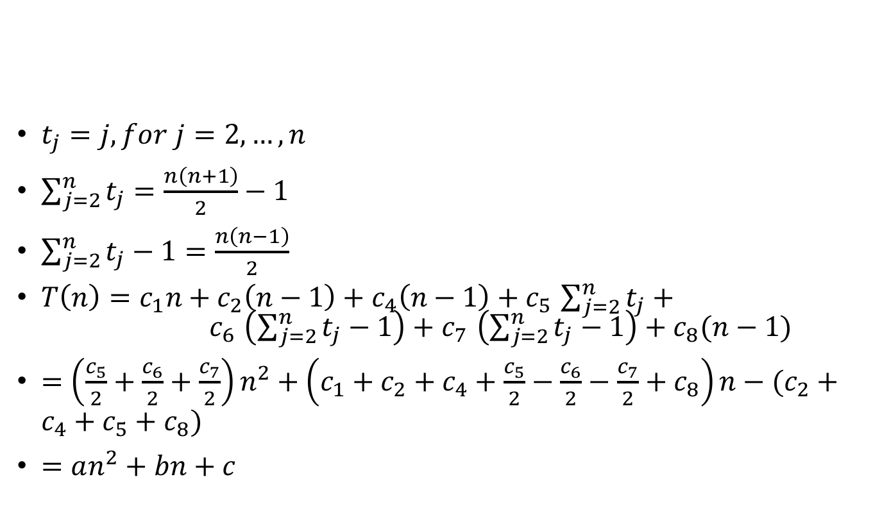
Worst case
$t_{j}=j, for j=2,…,n$
$\sum_{j=2}^{n}{t_{j}}=\frac{n\left(n+1\right)}{2}−1$
$\sum_{j=2}^{n}{t_{j}}−1=\frac{n\left(n−1\right)}{2}$
$T\left(n\right)=c_{1}n+c_{2}\left(n−1\right)+c_{4}\left(n−1\right)+c_{5}$ $\sum_{j=2}^{n}{t_{j}}+$ $c_{6}$ $\left(\sum_{j=2}^{n}{t_{j}}−1\right)+c_{7} \left(\sum_{j=2}^{n}{t_{j}}−1\right)+c_{8}(n−1)$
$=\left(\frac{c_{5}}{2}+\frac{c_{6}}{2}+\frac{c_{7}}{2}\right)n^{2}+\left(c_{1}+c_{2}+c_{4}+\frac{c_{5}}{2}−\frac{c_{6}}{2}−\frac{c_{7}}{2}+c_{8}\right)n−(c_{2}+c_{4}+c_{5}+c_{8})$
$=an^{2}+bn+c$
i | 1 | 2 | 3 | 4 | 5 | 6
A[i] | 6 | 5 | 4 | 3 | 2 | 1

Slide 9
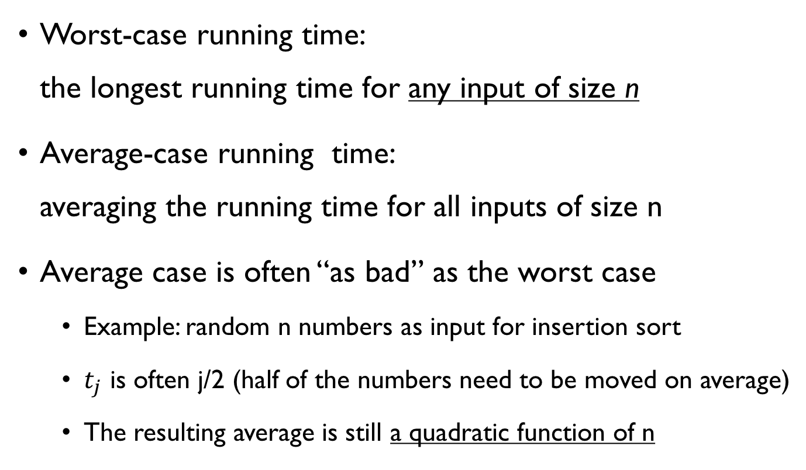
Worst-case and average-case analysis
Worst-case running time: the longest running time for any input of size n
Average-case running time: averaging the running time for all inputs of size n
Average case is often “as bad” as the worst case
Example: random n numbers as input for insertion sort
$t_{j}$ is often j/2 (half of the numbers need to be moved on average)
The resulting average is still a quadratic function of n
Notes:
For some algorithms, the worst case occurs fairly often. Example: database: worst case when the information is not found in the dB.

Slide 10
A more mathematical / theoretical approach – Asymptotic analysis
Motivation:
We often don’t care about the exact execution time (with great precision)
We’d like to compare the performance of a few algorithms and choose the best
For LARGE input size n
Alternative approach: asymptotic analysis
The ORDER of the growth of the running time
How the running time increases with the input size in the limit, as the input size grows without bound.

Slide 11

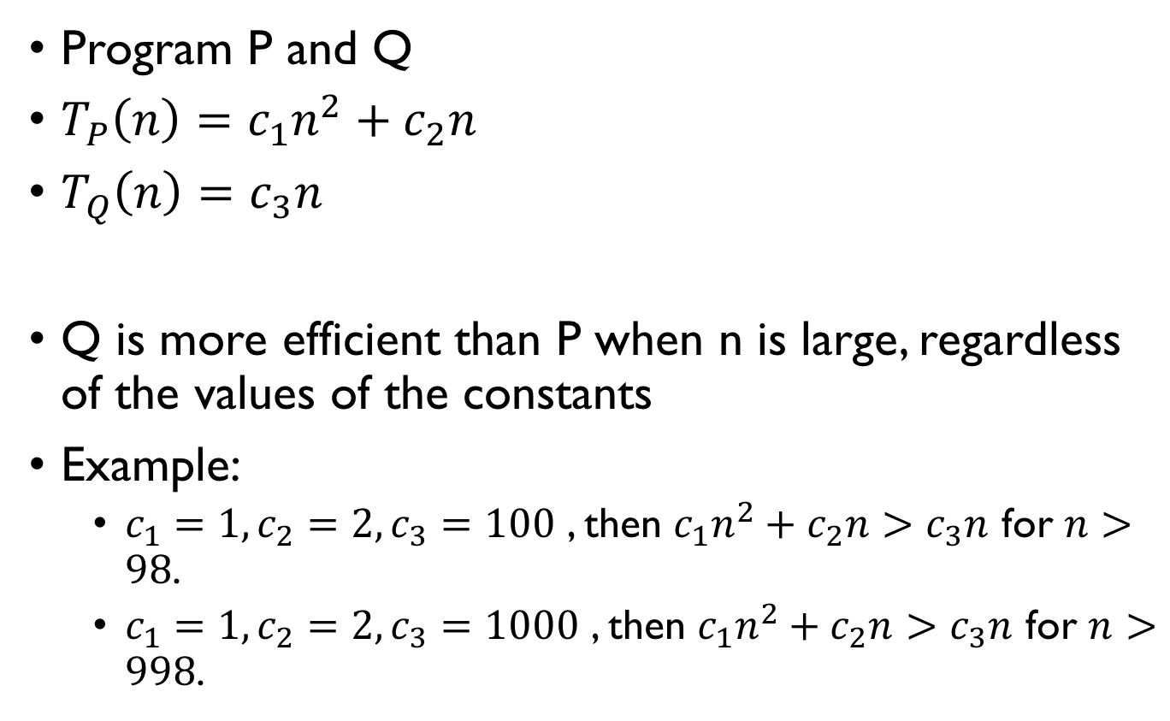
Example
Program P and Q
$T_{P}\left(n\right)=c_{1}n^{2}+c_{2}n$
$T_{Q}\left(n\right)=c_{3}n$
Q is more efficient than P when n is large, regardless of the values of the constants
Example:
$c_{1}=1,c_{2}=2,c_{3}=100$ , then $c_{1}n^{2}+c_{2}n>c_{3}n$ for $n>98$.
$c_{1}=1,c_{2}=2,c_{3}=1000$ , then $c_{1}n^{2}+c_{2}n>c_{3}n$ for $n>998$.
“小時候胖不算胖”
Notes:
Therefore the values of the constants are not very relevant when performing asymptotic analysis.

Slide 12
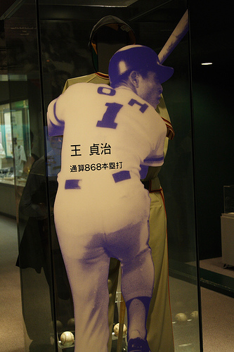
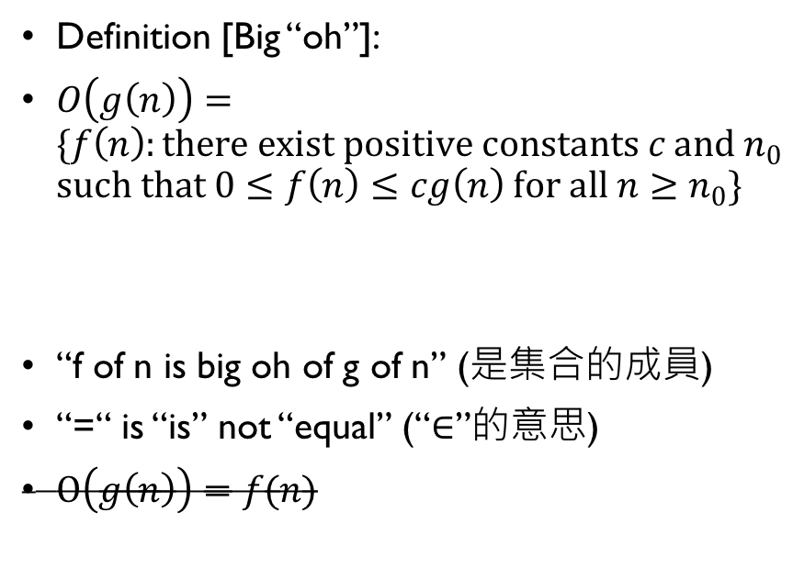
Asymptotic Notation – Big OH
Definition [Big “oh”]:
$O\left(g\left(n\right)\right)=\{f\left(n\right):there exist positive constants c and n_{0}$ $such that 0≤f\left(n\right)≤cg\left(n\right) for all n≥n_{0}\}$
“f of n is big oh of g of n” (是集合的成員)
“=“ is “is” not “equal” (“$∈$”的意思)
$Ο\left(g\left(n\right)\right)=f(n)$
Sataharu Oh is the upper bound for no. of homerun hit
Notes:
f(n) often represents the running time or space used of an algorithm.

Slide 13
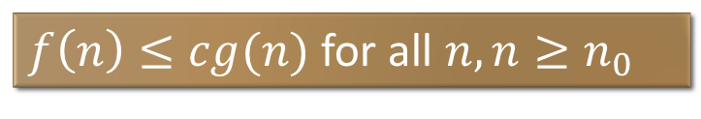
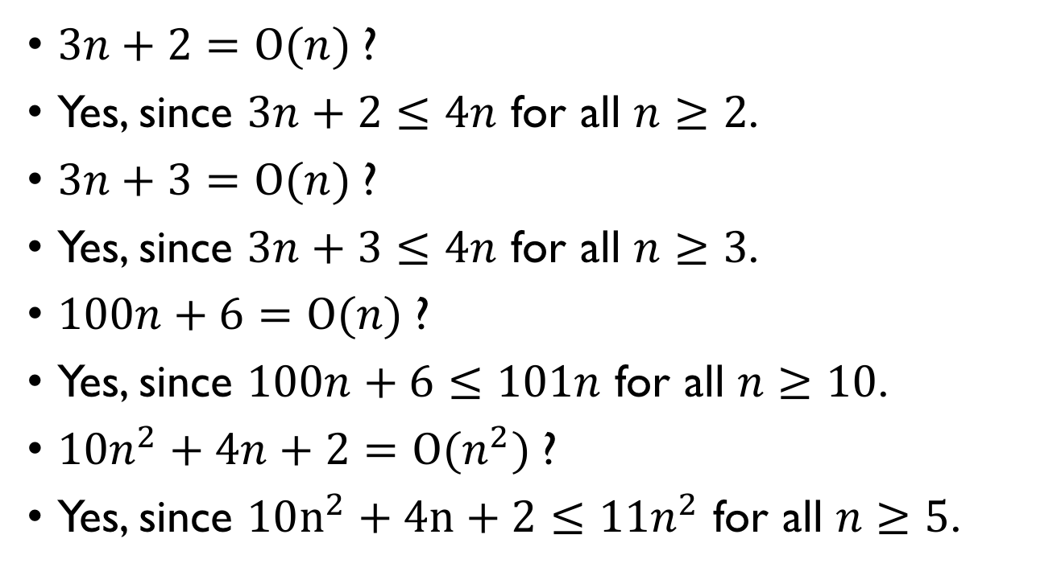
Example
$3n+2=Ο(n)$?
Yes, since $3n+2≤4n$ for all $n≥2$.
$3n+3=Ο(n)$?
Yes, since $3n+3≤4n$ for all $n≥3$.
$100n+6=Ο(n)$?
Yes, since $100n+6≤101n$ for all $n≥10$.
$10n^{2}+4n+2=Ο(n^{2})$?
Yes, since $10n^{2}+4n+2≤11n^{2}$ for all $n≥5$.
$f\left(n\right)≤cg(n)$ for all $n,n≥n_{0}$

Slide 14
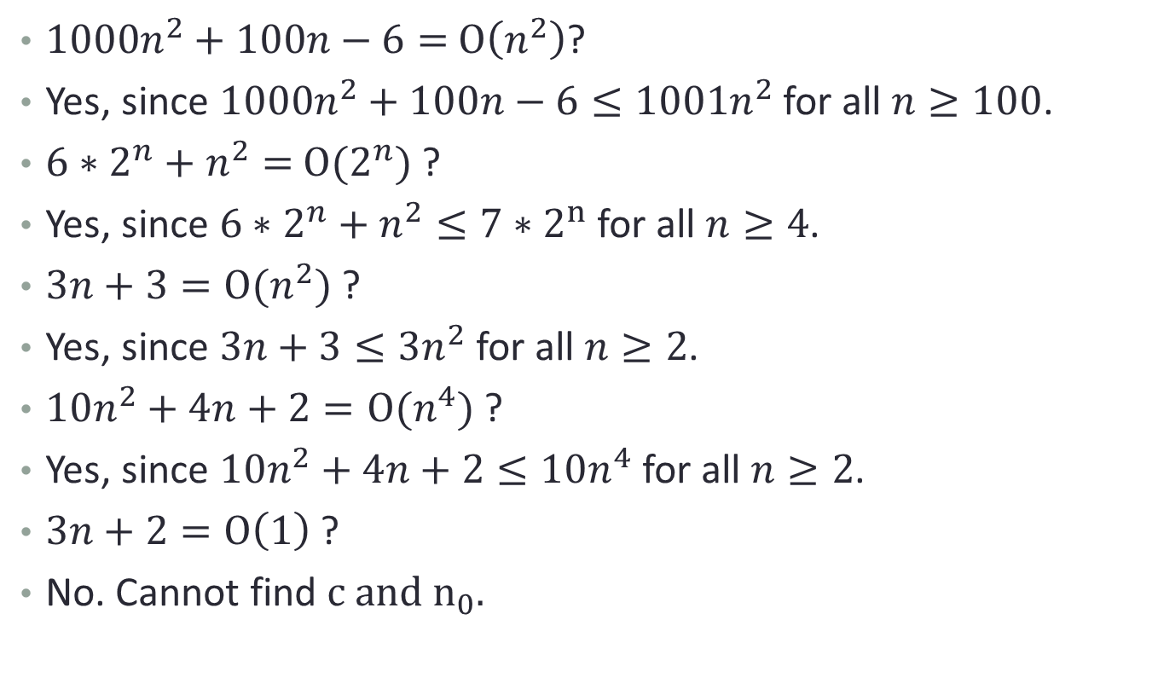
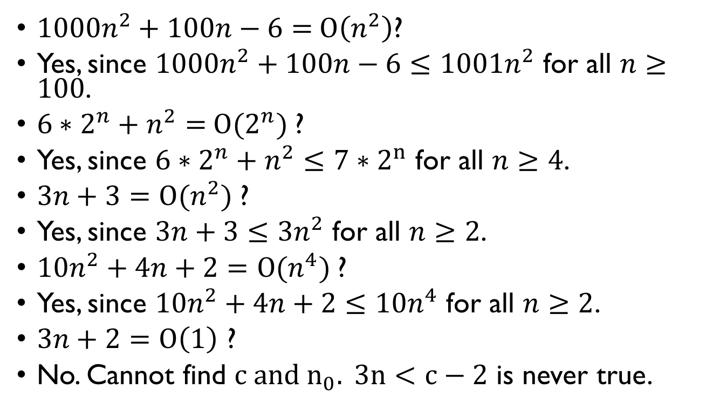
Example
$1000n^{2}+100n−6=$ $Ο\left(n^{2}\right)$?
Yes, since $1000n^{2}+100n−6≤1001n^{2}$ for all $n≥100$.
$6∗2^{n}+n^{2}=$ $Ο(2^{n})$?
Yes, since $6∗2^{n}+n^{2}≤7∗2^{n}$ for all $n≥4$.
$3n+3=Ο(n^{2})$?
Yes, since $3n+3≤3n^{2}$ for all $n≥2$.
$10n^{2}+4n+2=Ο(n^{4})$?
Yes, since $10n^{2}+4n+2≤10n^{4}$ for all $n≥2$.
$3n+2=Ο\left(1\right)$ ?
No. Cannot find $c and n_{0}. 3n<c−2$ is never true.
$f\left(n\right)≤cg(n)$ for all $n,n≥n_{0}$

Slide 15


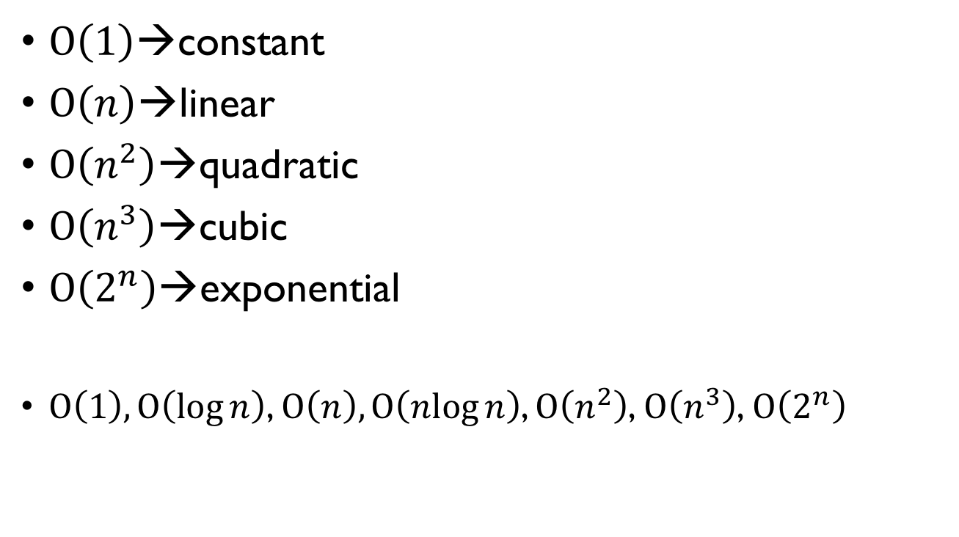
The World of Big Oh
$Ο\left(1\right)$→constant
$Ο\left(n\right)$→linear
$Ο\left(n^{2}\right)$→quadratic
$Ο\left(n^{3}\right)$→cubic
$Ο\left(2^{n}\right)$→exponential
$Ο\left(1\right),Ο\left(\log{n}\right)$, $Ο\left(n\right), Ο\left(\operatorname{nlog}{n}\right)$, $Ο\left(n^{2}\right)$, $Ο\left(n^{3}\right)$, $Ο\left(2^{n}\right)$
Faster
Slower

Slide 16
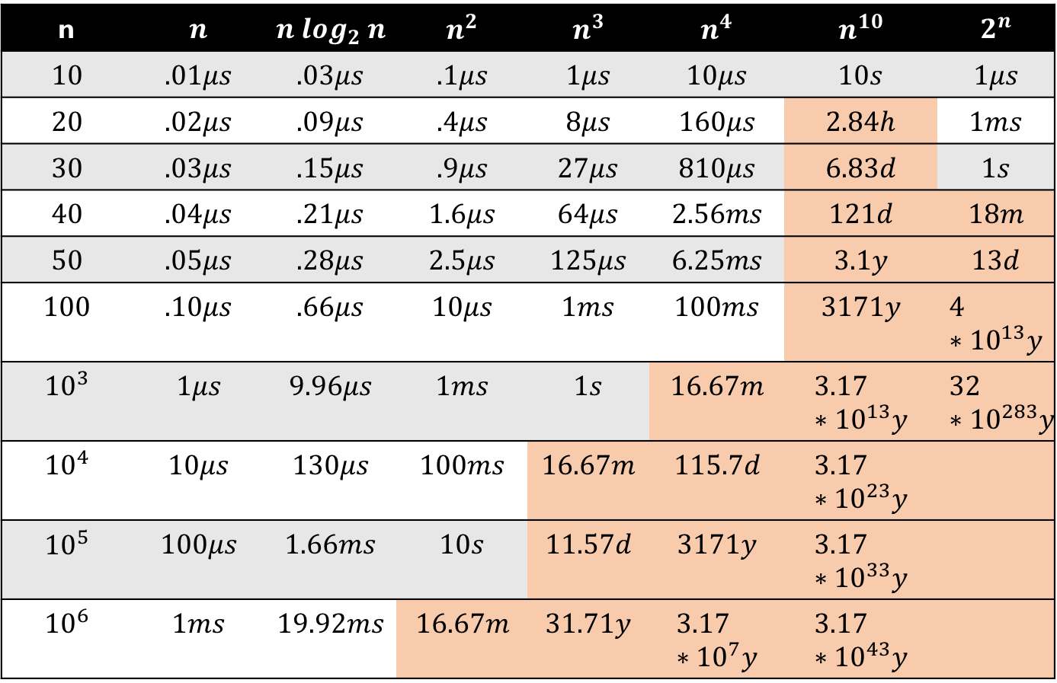
On a 1 billion-steps-per-sec computer
n | $$n$$ | $$n log_{2} n$$ | $$n^{2}$$ | $$n^{3}$$ | $$n^{4}$$ | $$n^{10}$$ | $$2^{n}$$
$$10$$ | $$.01μs$$ | $$.03μs$$ | $$.1μs$$ | $$1μs$$ | $$10μs$$ | $$10s$$ | $$1μs$$
$$20$$ | $$.02μs$$ | $$.09μs$$ | $$.4μs$$ | $$8μs$$ | $$160μs$$ | $$2.84h$$ | $$1ms$$
$$30$$ | $$.03μs$$ | $$.15μs$$ | $$.9μs$$ | $$27μs$$ | $$810μs$$ | $$6.83d$$ | $$1s$$
$$40$$ | $$.04μs$$ | $$.21μs$$ | $$1.6μs$$ | $$64μs$$ | $$2.56ms$$ | $$121d$$ | $$18m$$
$$50$$ | $$.05μs$$ | $$.28μs$$ | $$2.5μs$$ | $$125μs$$ | $$6.25ms$$ | $$3.1y$$ | $$13d$$
$$100$$ | $$.10μs$$ | $$.66μs$$ | $$10μs$$ | $$1ms$$ | $$100ms$$ | $$3171y$$ | $$4∗{10}^{13}y$$
$${10}^{3}$$ | $$1μs$$ | $$9.96μs$$ | $$1ms$$ | $$1s$$ | $$16.67m$$ | $$3.17∗{10}^{13}y$$ | $$32∗{10}^{283}y$$
$${10}^{4}$$ | $$10μs$$ | $$130μs$$ | $$100ms$$ | $$16.67m$$ | $$115.7d$$ | $$3.17∗{10}^{23}y$$
$${10}^{5}$$ | $$100μs$$ | $$1.66ms$$ | $$10s$$ | $$11.57d$$ | $$3171y$$ | $$3.17∗{10}^{33}y$$
$${10}^{6}$$ | $$1ms$$ | $$19.92ms$$ | $$16.67m$$ | $$31.71y$$ | $$3.17∗{10}^{7}y$$ | $$3.17∗{10}^{43}y$$
Notes:
Billion = Giga
1 Billion/s = 1 GHz

Slide 17


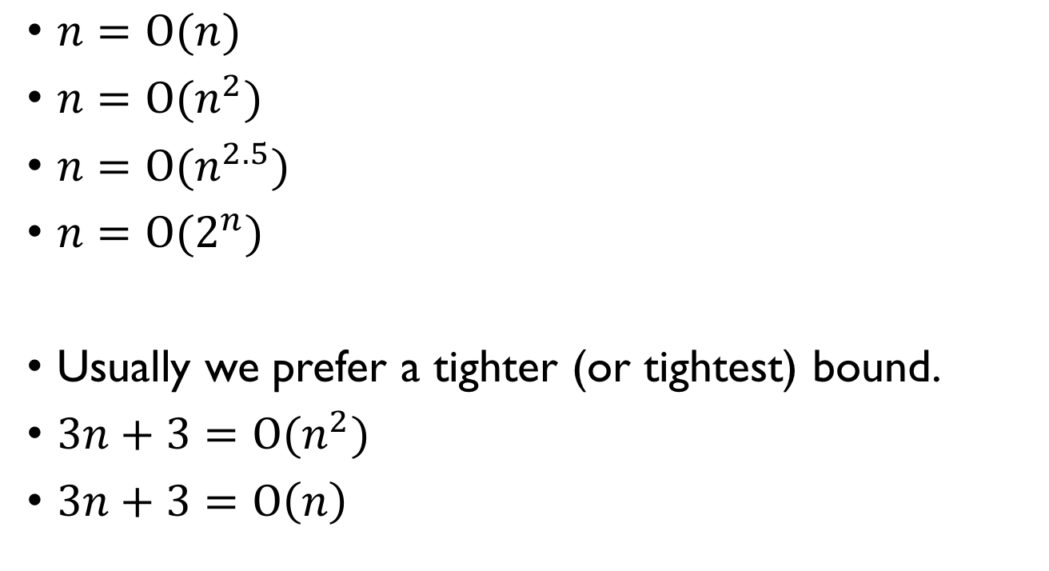
Is it a tight upper bound?
$n=Ο(n)$
$n=Ο(n^{2})$
$n=Ο(n^{2.5})$
$n=Ο(2^{n})$
Usually we prefer a tighter (or tightest) bound.
$3n+3=Ο(n^{2})$
$3n+3=Ο\left(n\right)$
Notes:
So that it reflects the actual running time of the algorithm.

Slide 18
Conditions
n in O(g(n)) is a natural number: {0,1,2,…}
Member f(n) of O(g(n)) is asymptotically nonnegative (f(n) is nonnegative when n is very large)
g(n) is asymptotically nonnegative
The above applies to all asymptotic notations.

Slide 19

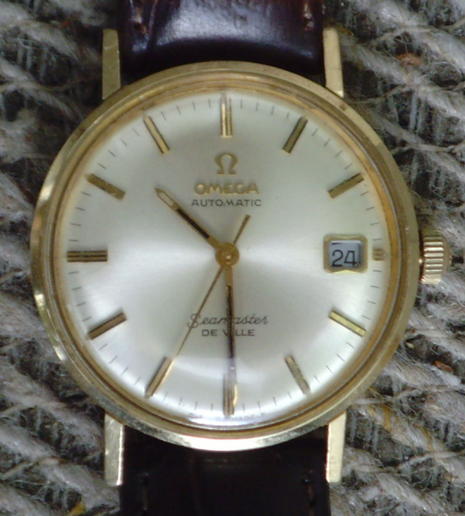
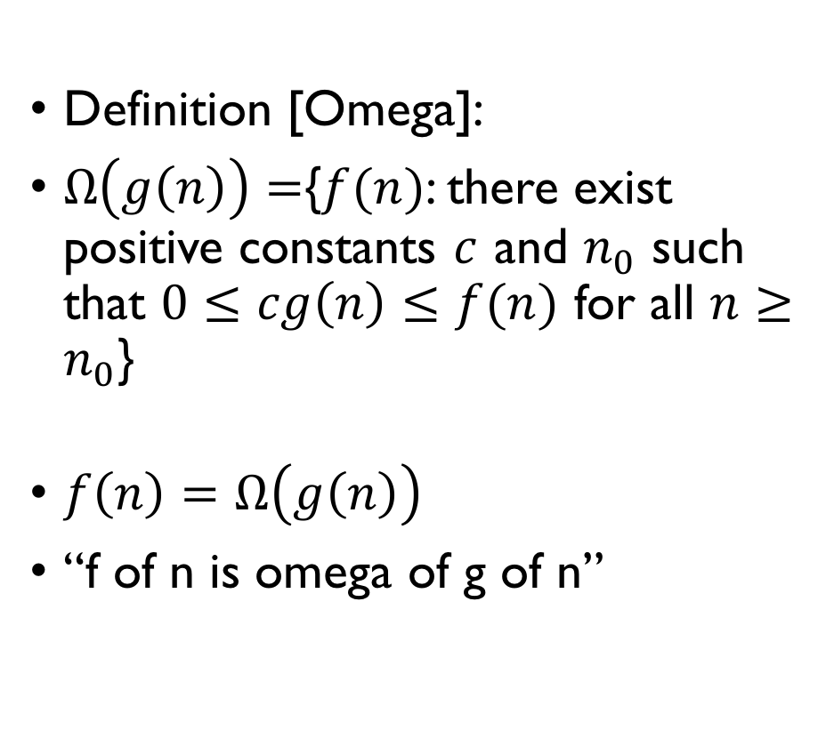
Asymptotic Notation – Omega
Definition [Omega]:
$Ω\left(g\left(n\right)\right)=${$f(n)$: there exist positive constants $c$ and $n_{0}$ such that $0≤cg\left(n\right)≤f(n)$ for all $n≥n_{0}$}
$f\left(n\right)=Ω\left(g\left(n\right)\right)$
“f of n is omega of g of n”

Slide 20
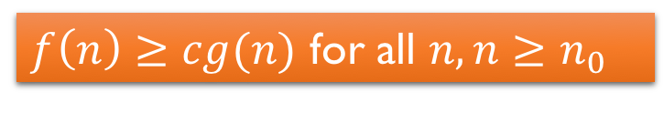
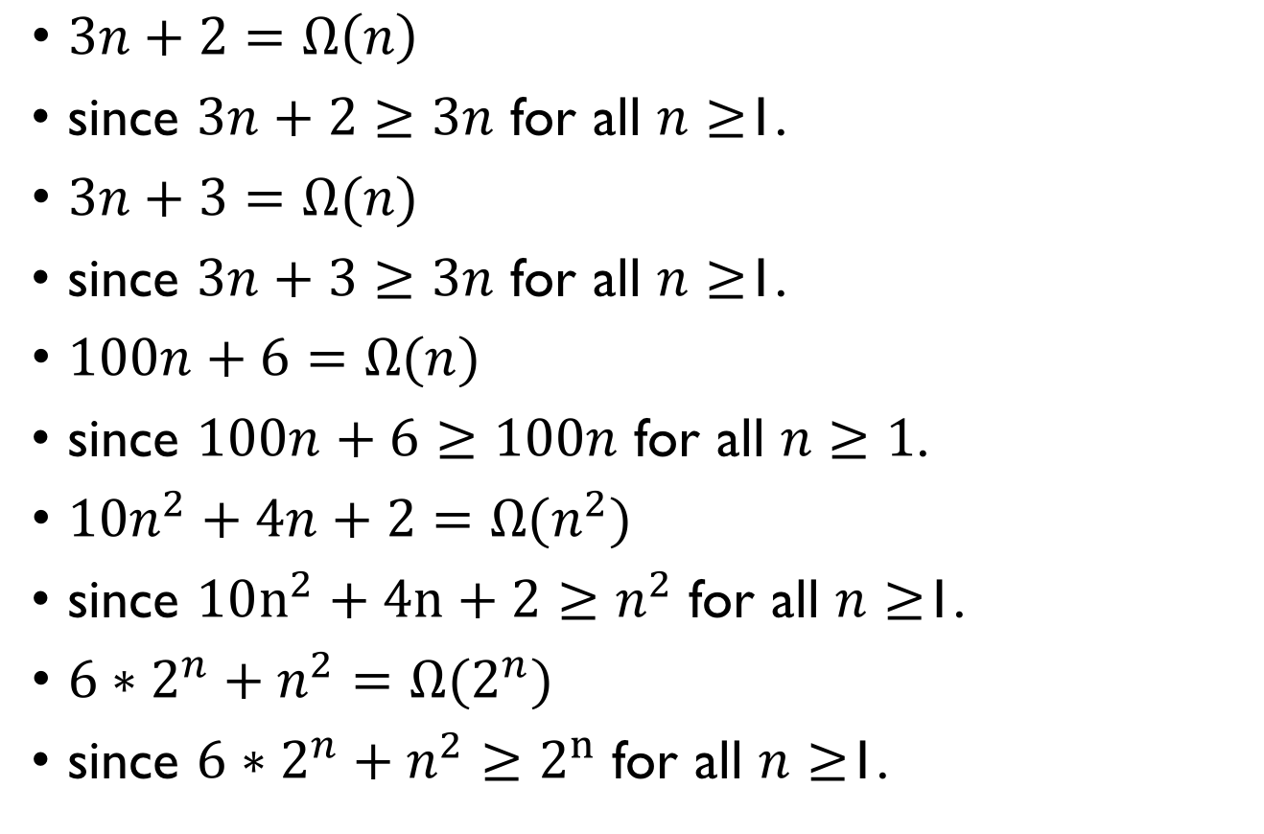
Examples
$3n+2=Ω\left(n\right)$
since $3n+2≥3n$ for all $n≥$1.
$3n+3=Ω(n)$
since $3n+3≥3n$ for all $n≥$1.
$100n+6=Ω(n)$
since $100n+6≥100n$ for all $n≥1$.
$10n^{2}+4n+2=Ω(n^{2})$
since $10n^{2}+4n+2≥n^{2}$ for all $n≥$1.
$6∗2^{n}+n^{2}=Ω(2^{n})$
since $6∗2^{n}+n^{2}≥2^{n}$ for all $n≥$1.
$f\left(n\right)≥cg(n)$ for all $n,n≥n_{0}$

Slide 21
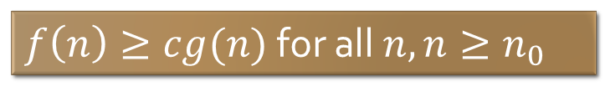
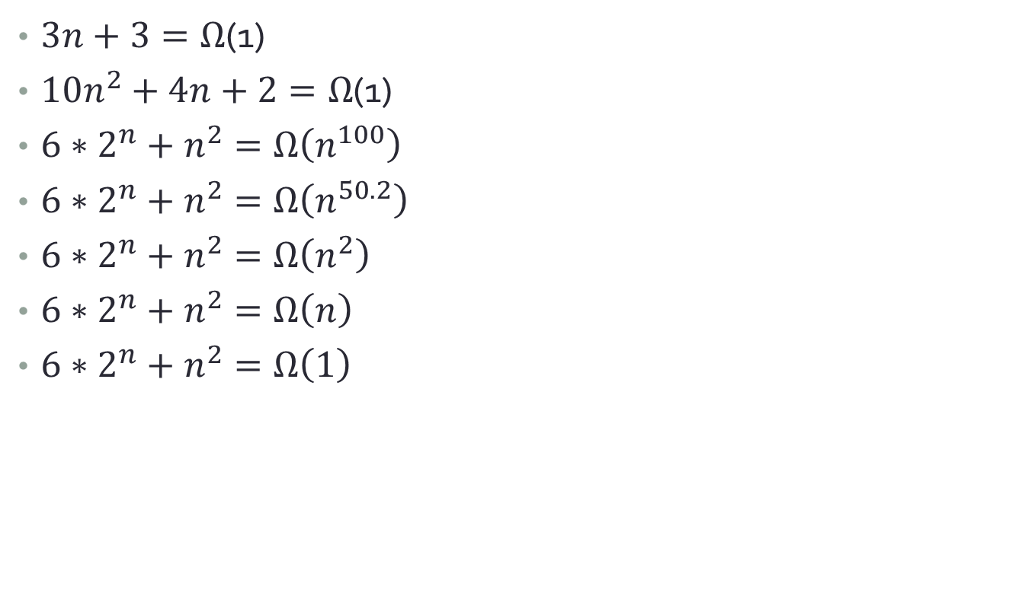
Examples
$3n+3=Ω$(1)
$10n^{2}+4n+2=Ω$(1)
$6∗2^{n}+n^{2}=Ω\left(n^{100}\right)$
$6∗2^{n}+n^{2}=Ω\left(n^{50.2}\right)$
$6∗2^{n}+n^{2}=Ω\left(n^{2}\right)$
$6∗2^{n}+n^{2}=Ω\left(n\right)$
$6∗2^{n}+n^{2}=Ω\left(1\right)$
$f\left(n\right)≥cg(n)$ for all $n,n≥n_{0}$

Slide 22

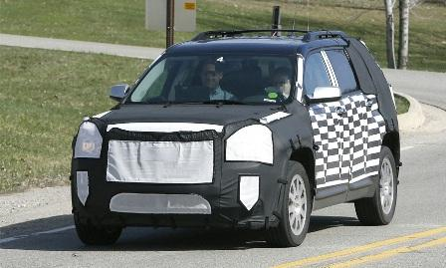
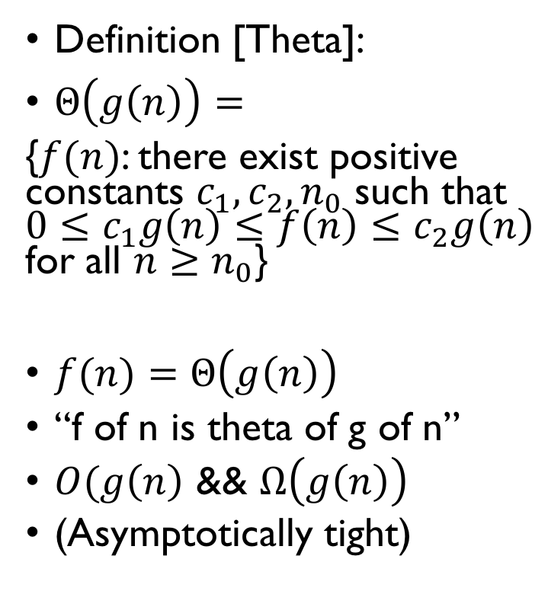
Asymptotic Notation – Theta
Definition [Theta]:
$Θ\left(g\left(n\right)\right)=$
{$f(n)$: there exist positive constants $c_{1}, c_{2}, n_{0}$ such that $0≤c_{1}g\left(n\right)≤f\left(n\right)≤c_{2}g\left(n\right)$ for all $n≥n_{0}$}
$f(n)=Θ\left(g\left(n\right)\right)$
“f of n is theta of g of n”
$O(g\left(n\right)$ && $Ω\left(g\left(n\right)\right)$
(Asymptotically tight)
Theta Platform
GMC Terrain

Slide 23
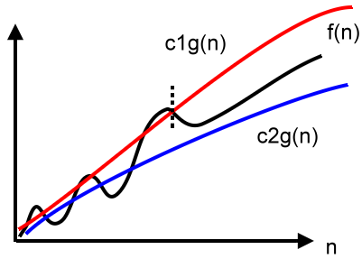
Visualization
Big Oh: red
Omega: blue
Theta: red & blue
Notes:
Both the upper bound and the lower bound grow “at the same order” as f(n)

Slide 24
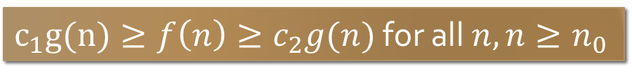
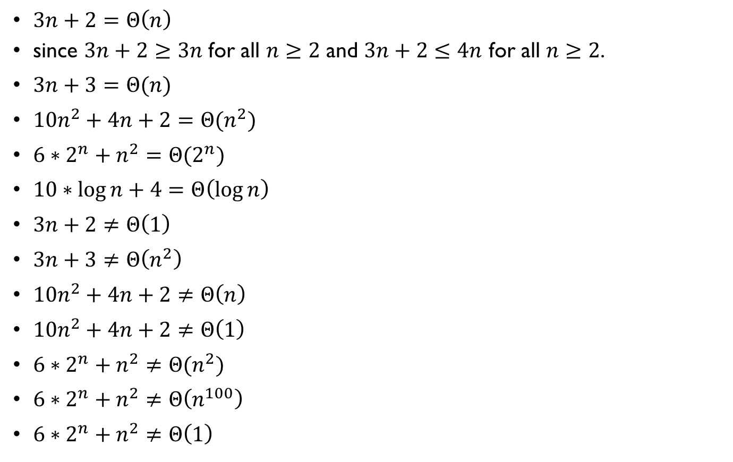
Example
$3n+2=Θ\left(n\right)$
since $3n+2≥3n$ for all $n≥2$ and $3n+2≤4n$ for all $n≥2$.
$3n+3=Θ(n)$
$10n^{2}+4n+2=Θ(n^{2})$
$6∗2^{n}+n^{2}=Θ(2^{n})$
$10∗\log{n}+4=Θ\left(\log{n}\right)$
$3n+2≠Θ\left(1\right)$
$3n+3≠Θ\left(n^{2}\right)$
$10n^{2}+4n+2≠Θ\left(n\right)$
$10n^{2}+4n+2≠Θ\left(1\right)$
$6∗2^{n}+n^{2}≠Θ(n^{2})$
$6∗2^{n}+n^{2}≠Θ\left(n^{100}\right)$
$6∗2^{n}+n^{2}≠Θ\left(1\right)$
$c_{1}g(n)≥f\left(n\right)≥c_{2}g(n)$ for all $n,n≥n_{0}$

Slide 25
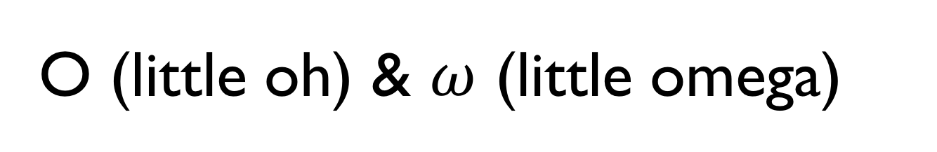
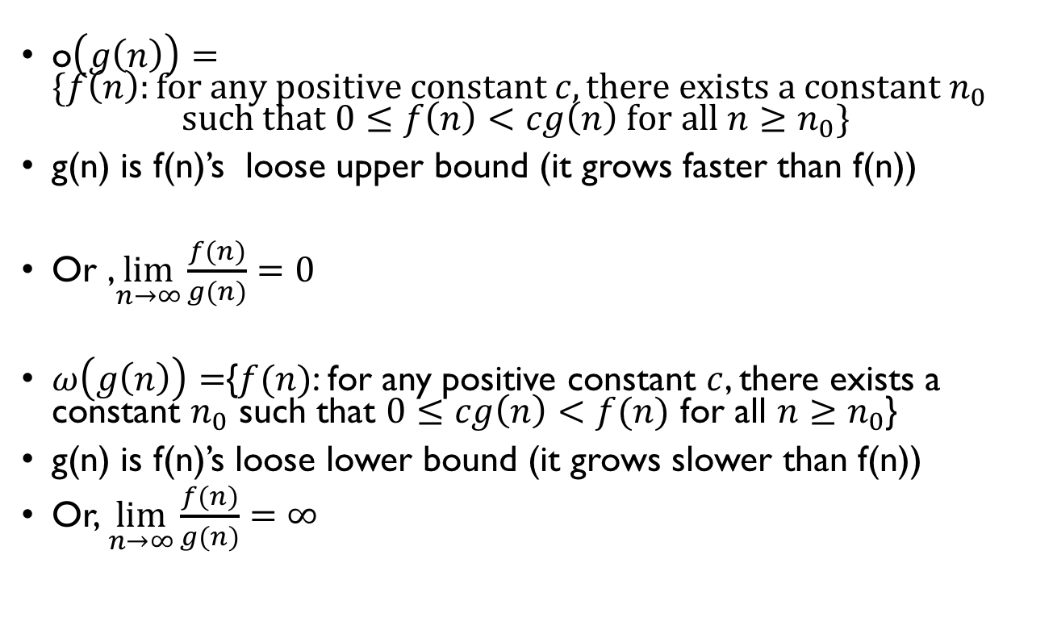
O (little oh) & $ω$ (little omega)
o$\left(g\left(n\right)\right)=\{f\left(n\right):for any positive constant c, there exists a constant n_{0}$ $such that 0≤f\left(n\right)<cg\left(n\right) for all n≥n_{0}\}$
g(n) is f(n)’s loose upper bound (it grows faster than f(n))
Or ,$\lim_{n→∞}{\frac{f\left(n\right)}{g\left(n\right)}}=0$
$ω\left(g\left(n\right)\right)=${$f(n)$: for any positive constant $c$, there exists a constant $n_{0}$ such that $0≤cg\left(n\right)<f(n)$ for all $n≥n_{0}$}
g(n) is f(n)’s loose lower bound (it grows slower than f(n))
Or, $\lim_{n→∞}{\frac{f\left(n\right)}{g\left(n\right)}}=∞$

Slide 26
Practice Problems

Slide 27
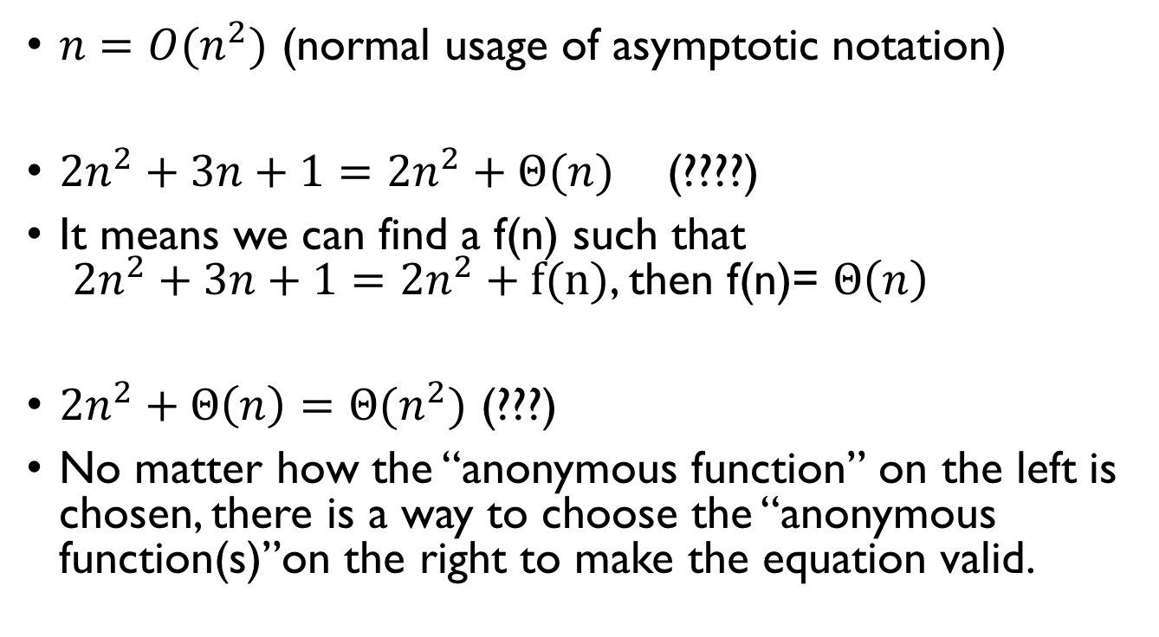
Equation and inequality
$n=O(n^{2})$ (normal usage of asymptotic notation)
$2n^{2}+3n+1=2n^{2}+Θ(n)$ (????)
It means we can find a f(n) such that $2n^{2}+3n+1=2n^{2}+f(n)$, then f(n)= $Θ\left(n\right)$
$2n^{2}+Θ\left(n\right)=Θ(n^{2})$ (???)
No matter how the “anonymous function” on the left is chosen, there is a way to choose the “anonymous function(s)”on the right to make the equation valid.

Slide 28





どっちの料理ショー: DOTCH??
$$Θ(n^{2})$$
$$Θ(n)$$
$$n^{2} ms$$
$${10}^{6}n ms$$

Slide 29
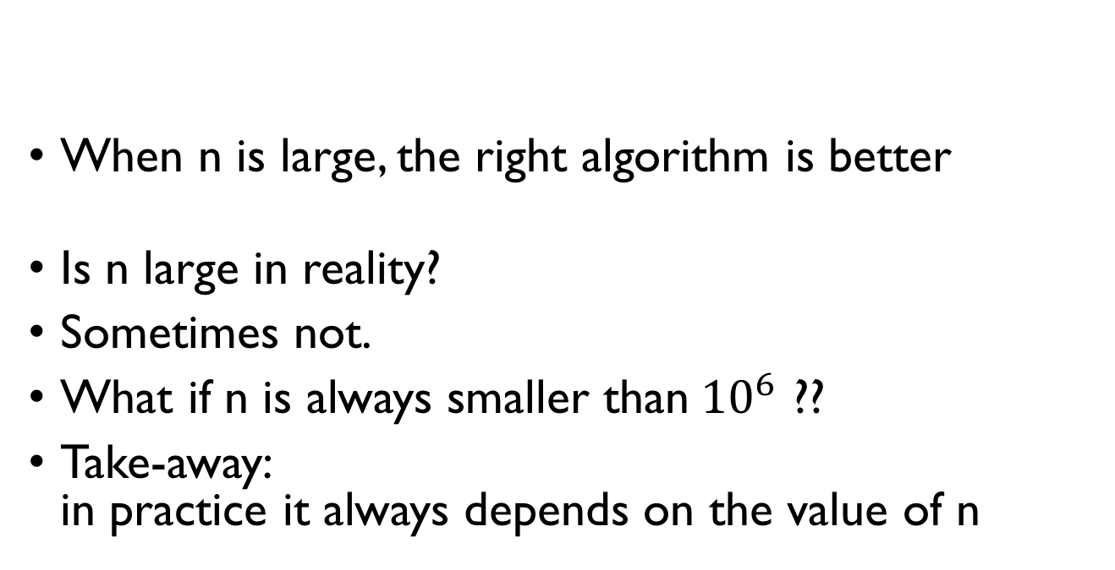




DOTCH…
$$Θ(n^{2})$$
$$Θ(n)$$
$$n^{2} ms$$
$${10}^{6}n ms$$
When n is large, the right algorithm is better
Is n large in reality?
Sometimes not.
What if n is always smaller than${10}^{6}$ ??
Take-away: in practice it always depends on the value of n

